Slide 1


Slide 2
AWT to Swing
AWT: Abstract Windowing Toolkit
    import java.awt.*
Swing: new with Java2
    import javax.swing.*
    Extends AWT
    Tons o’ new improved components
    Standard dialog boxes, tooltips, …
    Look-and-feel, skins
    Event listeners
API:
    http://java.sun.com/j2se/1.3/docs/api/index.html

Slide 3
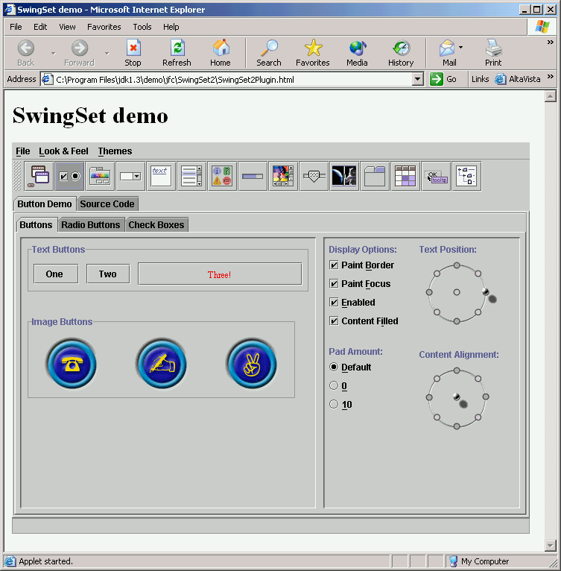
Swing Set Demo
J2sdk/demo/jfc/SwingSet2
Many predefined
GUI components

Slide 4
GUI Component API
Java: GUI component = class
Properties
Methods
Events
JButton

Slide 5
Using a GUI Component
Create it
    Instantiate object: b = new JButton(“press me”);
Configure it
    Properties: b.text = “press me”; [avoided in java]
    Methods: b.setText(“press me”);
Add it
    panel.add(b);
Listen to it
    Events: Listeners
JButton

Slide 6
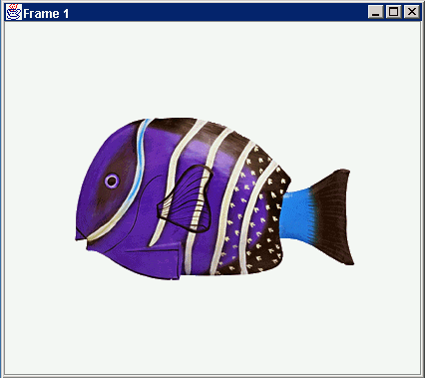
Anatomy of an Application GUI
JFrame
JFrame
JPanel
containers
JPanel
JButton
JButton
JLabel
JLabel
Internal structure
GUI

Slide 7
Using a GUI Component 2
Create it
Configure it
Add children (if container)
Add to parent (if not JFrame)
Listen to it
order
important

Slide 8
Build from bottom up
Listener
Create:
    Frame
    Panel
    Components
    Listeners
Add: (bottom up)
    listeners into components
    components into panel
    panel into frame
JLabel
JButton
JPanel
JFrame

Slide 9
Code
press me
JFrame f = new JFrame(“title”);
JPanel p = new JPanel( );
JButton b = new JButton(“press me”);
p.add(b); // add button to panel
f.setContentPane(p); // add panel to frame
f.show();

Slide 10
Application Code
press me
import javax.swing.*;
class hello {
public static void main(String[] args){
JFrame f = new JFrame(“title”);
JPanel p = new JPanel();
JButton b = new JButton(“press me”);
p.add(b); // add button to panel
f.setContentPane(p); // add panel to frame
f.show();
}
}

Slide 11
Layout Manager Heuristics
null
FlowLayout
GridLayout
none,
programmer
sets x,y,w,h
Left to right,
Top to bottom
BorderLayout
CardLayout
GridBagLayout
n
c
One at a time
w
e
JButton
s

Slide 12
Combinations
JButton
JButton
JTextArea

Slide 13
Combinations
JButton
JButton
JFrame
n
JPanel: BorderLayout
c
JPanel: FlowLayout
JTextArea

Slide 14
Code: null layout
JFrame f = new JFrame(“title”);
JPanel p = new JPanel( );
JButton b = new JButton(“press me”);
b.setBounds(new Rectangle(10,10, 100,50));
p.setLayout(null); // x,y layout
p.add(b);
f.setContentPane(p);
press me

Slide 15
Code: FlowLayout
JFrame f = new JFrame(“title”);
JPanel p = new JPanel( );
FlowLayout L = new FlowLayout( );
JButton b1 = new JButton(“press me”);
JButton b2 = new JButton(“then me”);
p.setLayout(L);
p.add(b1);
p.add(b2);
f.setContentPane(p);
Set layout mgr before adding components
press me
then me

Slide 16
Applets
JApplet
JApplet is like a JFrame
Already has a panel
    Access panel with JApplet.getContentPane( )
import javax.swing.*;
class hello extends JApplet {
public void init(){
JButton b = new JButton(“press me”);
getContentPane().add(b);
}
}
contentPane
JButton

Slide 17
Applet Methods
Called by browser:
init( ) - initialization
start( ) - resume processing (e.g. animations)
stop( ) - pause
destroy( ) - cleanup
paint( ) - redraw stuff (‘expose’ event)

Slide 18
Application + Applet
import javax.swing.*;
class helloApp {
public static void main(String[] args){
// create Frame and put my mainPanel in it
JFrame f = new JFrame(“title”);
mainPanel p = new mainPanel();
f.setContentPane(p);
f.show();
}
}
class helloApplet extends JApplet {
public void init(){
// put my mainPanel in the Applet
mainPanel p = new mainPanel();
getContentPane().add(p);
}
}
// my main GUI is in here:
class mainPanel extends JPanel {
mainPanel(){
setLayout(new FlowLayout());
JButton b = new JButton(“press me”);
add(b);
}
}
Command line
Browser
JFrame
or
JApplet
contentPane
JPanel
JButton

Slide 19
What is an Event?
GUI components communicate with the rest of the applications through events.
The source of an event is the component that causes that event to occur.
The listener of an event is an object that receives the event and processes it appropriately.

Slide 20
Handling Events
Every time the user types a character or clicks the mouse, an event occurs.
Any object can be notified of any particular event.
To be notified for an event,
  The object has to be registered as an event listener on the appropriate event source.
  The object has to implement the appropriate interface.

Slide 21
Event-handling
Event object
interface (ActionListener)
the listener eg JFrame
when clicked
component eg button
during initialisation, component selects another object eg a JFrame, to be the listener
executes appropriate interface method ie actionPerformed

Slide 22
Interfaces
An interface is a set of methods
eg the ActionListener interface has just one method -
  public void actionPerformed(ActionEvent e)
A class can declare that it implements it eg
  public class Main implements ActionListener
Then it must actually define the methods in that interface Or the compiler will complain
Classes can implement multiple interfaces

Slide 23
An example of Event Handling
public class SwingApplication implements ActionListener {
...
JButton button = new JButton("I'm a Swing button!");
button.addActionListener(this);
....
public void actionPerformed(ActionEvent e) { numClicks++;
label.setText(labelPrefix + numClicks);
}
}

Slide 24
The Event Handling process
When an event is triggered, the JAVA runtime first determines its source and type.
If a listener for this type of event is registered with the source, an event object is created.
For each listener to this type of an event, the JAVA runtime invokes the appropriate event handling method to the listener and passes the event object as the parameter.

Slide 25
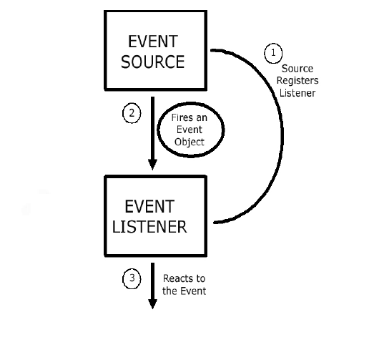
The Event Handling Process
(contd..)

Slide 26
What does an Event Handler require?
It just looks for 3 pieces of code!
First, in the declaration of the event handler class, one line of code must specify that the class implements either a listener interface or extends a class that implements a listener interface.
public class DemoClass implements ActionListener {

Slide 27
What does an Event Handler require? (contd..)
Second, it looks for a line of code which registers an instance of the event handler class as a listener of one or more components because, as mentioned earlier, the object must be registered as an event listener.
anyComponent.addActionListener(instanceOf DemoClass);

Slide 28
What does an Event Handler require? (contd..)
Third, the event handler must have a piece of code that implements the methods in the listener interface.
public void actionPerformed(ActionEvent e) {
...//code that reacts to the action...
}

Slide 29
Types of Events
Below, are some of the many kinds of events, swing components generate.
Act causing Event | Listener Type
User clicks a button, presses Enter, typing in text field | ActionListener
User closes a frame | WindowListener
Clicking a mouse button, while the cursor is over a component | MouseListener

Slide 30
Types of Events (contd..)
Act causing Event | Listener Type
User moving the mouse over a component | MouseMotionListener
Component becomes visible | ComponentListener
Table or list selection changes | ListSelectionListener

Slide 31
The Event classes
An event object has an event class as its reference data type.
The Event object class
  Defined in the java.util package.
The AWT Event class
  An immediate subclass of EventObject.
  Defined in java.awt package.
  Root of all AWT based events.

Slide 32
Event Listeners
Event listeners are the classes that implement the
<type>Listener interfaces.
Example:
1. ActionListener receives action events
2. MouseListener receives mouse events.
The following slides give you a brief overview on some of the listener types.

Slide 33
The ActionListener Method
It contains exactly one method.
Example:
public void actionPerformed(ActionEvent e)
The above code contains the handler for the ActionEvent e that occurred.

Slide 34
The MouseListener Methods
Event handling when the mouse is clicked.
public void mouseClicked(MouseEvent e)
Event handling when the mouse enters a component.
public void mouseEntered(MouseEvent e)
Event handling when the mouse exits a component.
public void mouseExited(MouseEvent e)

Slide 35
The MouseListener Methods (contd..)
Event handling when the mouse button is pressed on a component.
public void mousePressed(MouseEvent e)
Event handling when the mouse button is released on a component.
public void mouseReleased(MouseEvent e)

Slide 36
The MouseMotionListener Methods
Invoked when the mouse button is pressed over a component and dragged. Called several times as the mouse is dragged
public void mouseDragged(MouseEvent e)
Invoked when the mouse cursor has been moved onto a component but no buttons have been pushed.
public void mouseMoved(MouseEvent e)

Slide 37
The WindowListener Methods
Invoked when the window object is opened.
public void windowOpened(WindowEvent e)
Invoked when the user attempts to close the window object from the object’s system menu.
public void windowClosing(WindowEvent e)

Slide 38
The WindowListener Methods (contd..)
Invoked when the window object is closed as a result of calling dispose (release of resources used by the source).
public void windowClosed(WindowEvent e)
Invoked when the window is set to be the active window.
public void windowActivated(WindowEvent e)

Slide 39
The WindowListener Methods (contd..)
Invoked when the window object is no longer the active window
public void windowDeactivated(WindowEvent e)
Invoked when the window is minimized.
public void windowIconified(WindowEvent e)
Invoked when the window is changed from the minimized state to the normal state.
public void windowDeconified(WindowEvent e)

Slide 40
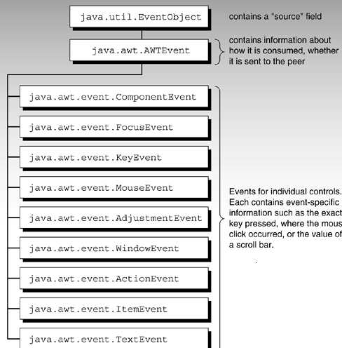
Hierarchy of event objects
Note: The number of event objects is much greater then specified in diagram…Due to space constraints, only some of them are represented in the figure
Courtesy: Safari.oreilly.com

Slide 41
Additional Listener Types
Item Listener
Key Listener
Property Change Listener
Table Model Listener
Change Listener
Container Listener
Document Listener
Focus Listener
Internal Frame Listener
The main purpose of the last few slides is to give you an idea as to how you can use event handlers in your programs. It is beyond the scope of the O’Reilly book to cover every event handler. See the JAVA tutorials for more information.

Slide 42
Adapter classes for Event Handling.
Why do you need adapter classes?
  Implementing all the methods of an interface involves a lot of work.
  If you are interested in only using some methods of the interface.
Adapter classes
  Built-in in JAVA
  Implement all the methods of each listener interface with more than one method.
  Implementation of all empty methods

Slide 43
Adapter classes - an Illustration.
Consider, you create a class that implements a MouseListener interface, where you require only a couple of methods to be implemented. If your class directly implements the MouseListener, you must implement all five methods of this interface.
Methods for those events you don't care about can have empty bodies

Slide 44
Illustration (contd..)
public class MyClass implements MouseListener {
... someObject.addMouseListener(this);
/* Empty method definition. */
public void mousePressed(MouseEvent e) { }
/* Empty method definition. */
public void mouseReleased(MouseEvent e) { }
/* Empty method definition. */
public void mouseEntered(MouseEvent e) { }
/* Empty method definition. */
public void mouseExited(MouseEvent e) { }
public void mouseClicked(MouseEvent e) {
//Event listener implementation goes here...
}
}

Slide 45
Illustration (contd..)
What is the result?
  The resulting collection of empty bodies can make the code harder to read and maintain.
To help you avoid implementing empty bodies, the API generally includes an adapter class for each listener interface with more than one method. For example, the MouseAdapter class implements the MouseListener interface.

Slide 46
How to use an Adapter class?
/* Using an adapter class
*/
public class MyClass extends MouseAdapter {
....
someObject.addMouseListener(this);
....
public void mouseClicked(MouseEvent e) {
...//Event listener implementation goes
// here
}
}

Slide 47
Using Inner classes for Event Handling
Consider that you want to use an adapter class but you don’t want your public class to inherit from the adapter class.
For example, you write an applet with some code to handle mouse events. As you know, JAVA does not permit multiple inheritance and hence your class cannot extend both the Applet and MouseAdapter classes.

Slide 48
Using Inner classes (contd..)
Use a class inside your Applet subclass that extends the MouseAdapter class.
public class MyClass extends Applet { ...
someObject.addMouseListener(new MyAdapter());
...
class MyAdapter extends MouseAdapter { public void mouseClicked(MouseEvent e) {
//Event listener implementation here... }
}
}

Slide 49
Creating GUI applications with Event Handling.
Guidelines:
  Create a GUI class
    Describes the appearance of your GUI application.
  Create a class implementing the appropriate listener interface
    May refer to the same class as step 1.

Slide 50
Creating GUI applications with Event Handling (contd..)
  In the implementing class
    Override all methods of the appropriate listener interface.
    Describe in each method how you want to handle the events.
    May give empty implementations for the methods you don’t need.

Slide 51
Creating GUI applications with Event Handling (contd..)
  Register the listener object with the source
    The object is an instantiation of the listener class specified in step 2.
    Use the add<Type>Listener method.

Slide 52
Design Considerations
The most important rule to keep in mind about event listeners is that they must execute quickly. Because, all drawing and event-listening methods are executed in the same thread, a slow event listener might make the program seem unresponsive. So, consider the performance issues also when you create event handlers in your programs.

Slide 53
Design Considerations
You can have choices on how the event listener has to be implemented. Because, one particular solution might not fit in all situations.
For example, you might choose to implement separate classes for different types of listeners. This might be a relatively easy architecture to maintain, but many classes can also result in reduced performance .

Slide 54
Common Event-Handling Issues
You are trying to handle certain events from a component, but it doesn’t generate the events it should.
  Make sure you have registered the right kind of listener to detect the events.
  Make sure you have registered the listener on the right object.
  Make sure you have implemented the event handler correctly, especially, the method signatures.

Slide 55
Common Event-Handling Issues (contd..)
Your combo box isn’t generating low level events like focus events.
  Since combo boxes are compound components, i.e., components implemented using multiple components, combo-boxes do not fire the low-level events that simple components fire.

Slide 56
Common Event-Handling Issues (contd..)
The document for an editor pane is not triggering document events.
  The document instance for an editor pane might change when loading text from a URL. Thus your listeners might be listening for events on an unused document.
  Hence, make sure that the code adjusts for possible changes to the document if your program dynamically loads text into an editor pane.

Slide 57
References
Drjslab.org
http://java.sun.com/docs/books/tutorial/uiswing/events/index.html
http://java.sun.com/docs/books/tutorial/uiswing/learn/example2.html#handlingEvents
http://safari.oreilly.com/0672315467/ch09

